Slide 1
Using Atlassian Jira

Slide 2
Jira is one of the leading technologies in agile project management. It is one of the most popular project management and issue tracking software tools.
It enables teams to plan, track, and manage tasks, projects, and software development workflows.
Jira provides a centralised platform for collaboration, task assignment, progress monitoring, and issue resolution.
With it, it is easy to create product backlog items, create a sprint, look at burndown charts, amongst other things.
OVERVIEW

Slide 3
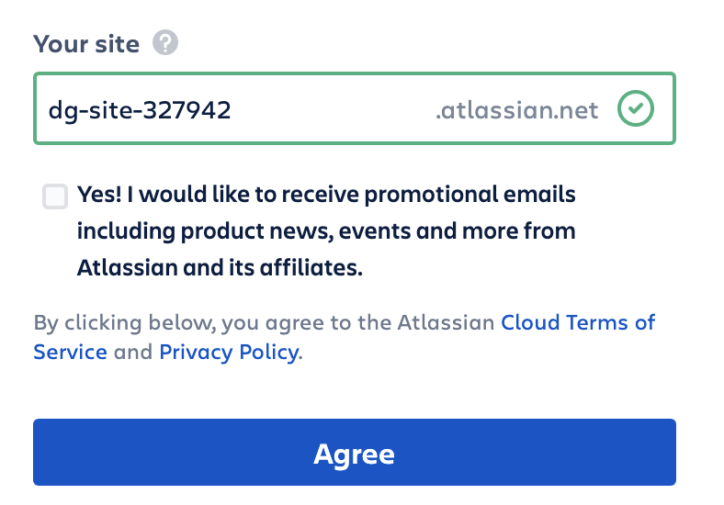
Atlassian Jira – Getting started
You will need to sign up here: https://www.atlassian.com/try/cloud/signup?bundle=jira-software&edition=free. Jira is free for up to 10 collaborators.
Follow these steps to sign up and use Jira:
Sign up to Jira. You may get some questions asking you about yourself, what sector you work in, etc. Feel free to skip these.
Create your Atlassian site. Multiple are allowed per account, so don't be concerned if you need to restart or create a new site.

Slide 4
Atlassian Jira – Getting started
Skip the marketing questions!
Atlassian will then set up your jira site - give it some time to do so.
Skip the marketing questions again!
Jira will ask what template would you like to create. For this set of steps, choose Scrum Template and Team-Managed Type.
Give the project a name and a key. (for reference, the key is a simpler way of referring to the project and will prefix the issues created within it, so make it descriptive and related).

Slide 5
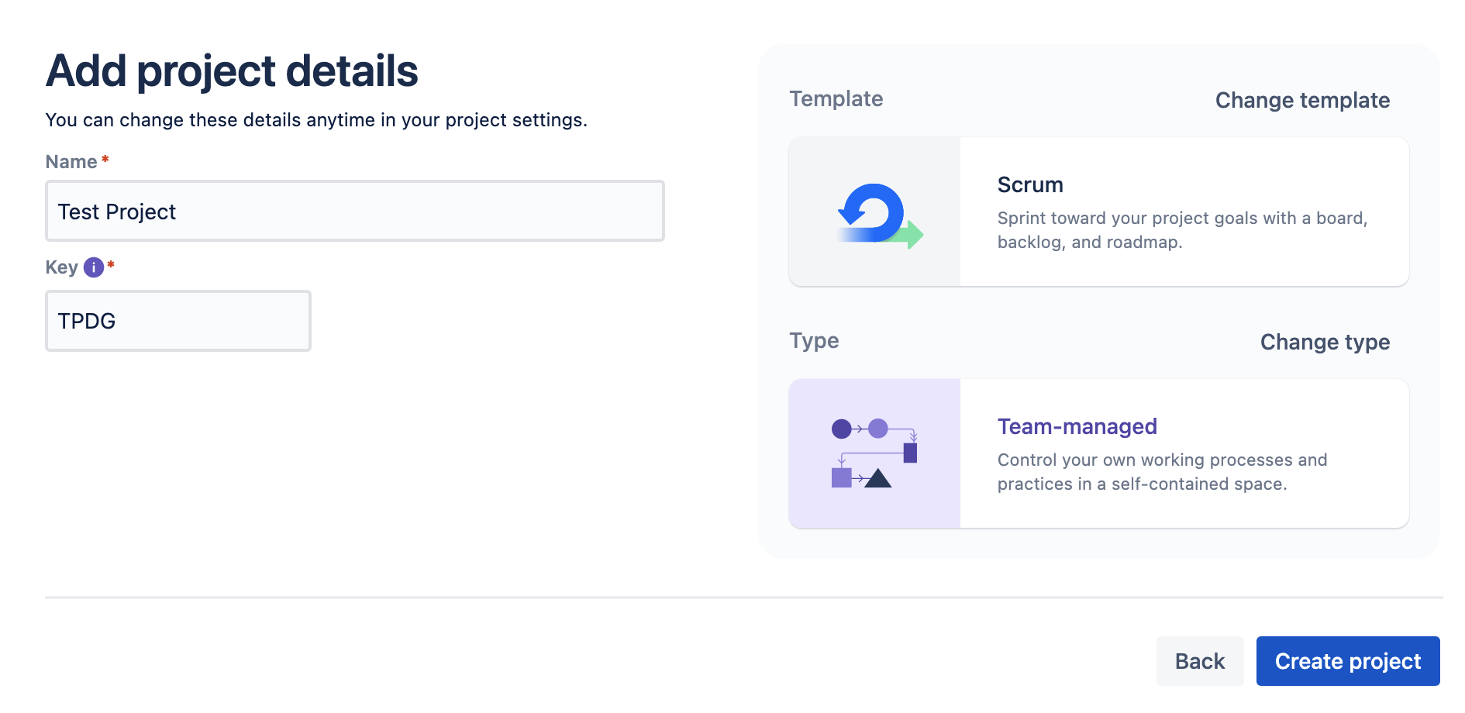
Atlassian Jira – Getting started
Once you have completed these steps, you should have something similar to this:
Click Create Project. Skip any further options if they appear. If asked to add teammates, simply select the Done button without filling in the fields.

Slide 6
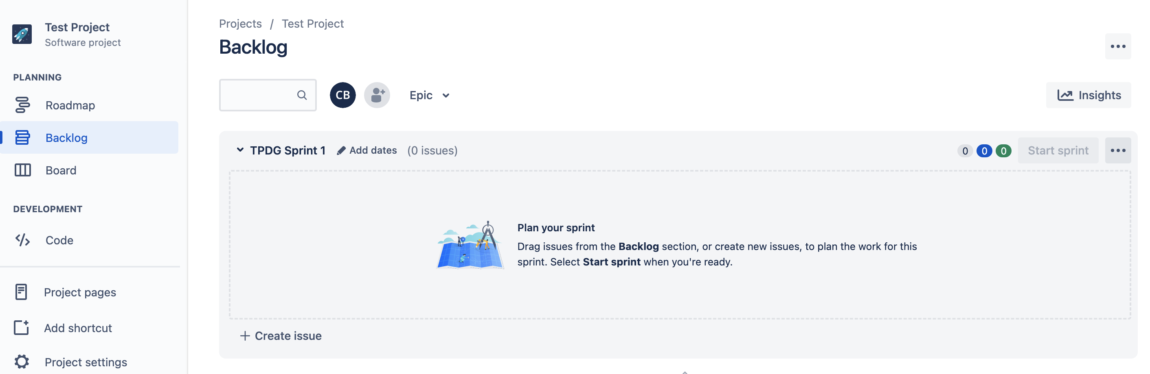
Atlassian Jira – Getting started
Once finished, you should now have a Jira site ready to use!

Slide 7
Adding to the Product Backlog

Slide 8
OVERVIEW
A core feature of Jira is issue — or ticket — management.
These issues are simply backlog items in Agile development, initially for the product backlog, and later pulled into the sprint backlog.
This section will discuss how to add items to a product backlog in Jira.

Slide 9
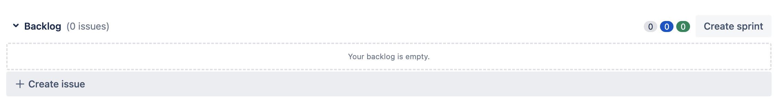
Adding to the Product Backlog
To add items to a product backlog in Jira, navigate to the home screen.
Select the Backlog button to take you to an empty backlog page. At the bottom of the page under Backlog, select the "+ Create issue" button.
Once selected, it should be replaced with a text box asking, "What needs to be done?" and a drop-down box.
Selecting the drop-down box first, you will be presented with several options, including Task (blue), Story (green), and Bug (red).
Note: If you need to create a custom issue type then you can do this by going into Project Settings > Issue Types
Notes:
It’s always worth showing the learners the Project Settings > Issue Types screen, because it contains lots of useful additions, such as “priority” which is a feature that can help us visualise our backlog item priorities, which is something discussed in a later section.

Slide 10
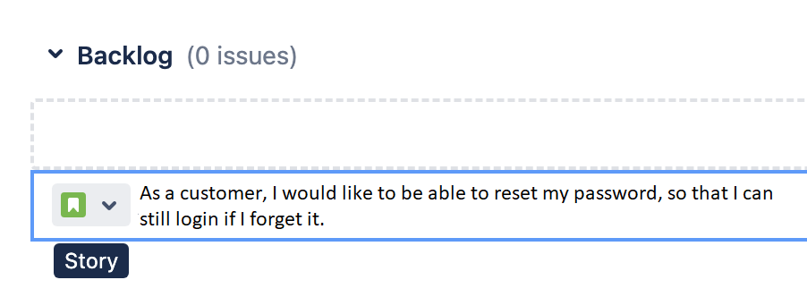
Adding to the Product Backlog
Ensure that the green option for story is selected (it should default to this option).
In the text box that reads "What needs to be done?", enter a user story and submit with the enter key.

Slide 11
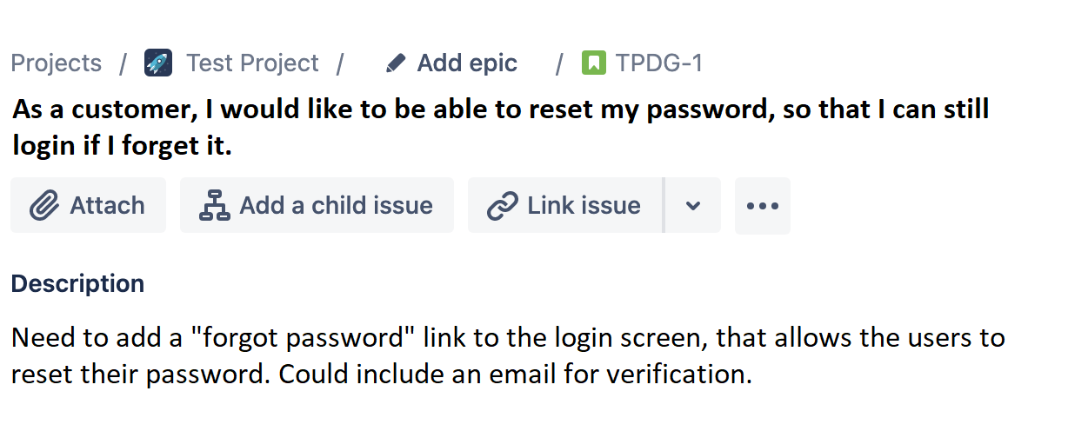
Adding to the Product Backlog
We can then click the story we just created and add more context to it, such as a description of the user story, its stage in the workflow (to do, doing, done), linked issues, story points, assignee, and much more:

Slide 12
Creating an Epic

Slide 13
OVERVIEW
An Epic is a large, overarching piece of work that is made up of multiple User Stories, which are then comprised of multiple Tasks.
Jira epics are a great way of joining multiple user stories together.
In this section, we will walk through the process of creating a Jira epic.

Slide 14
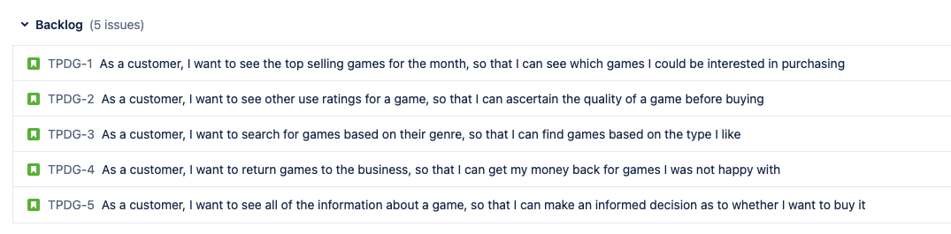
Creating an Epic
First, create a few user stories in your backlog:

Slide 15
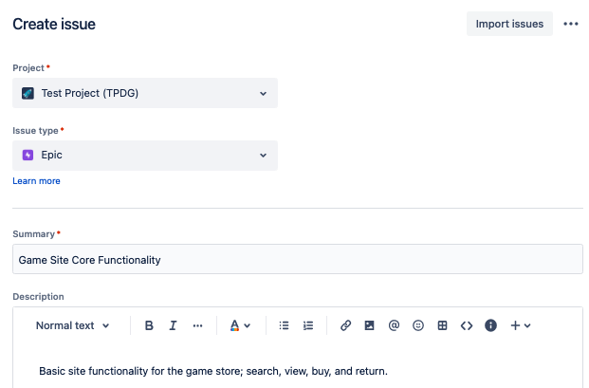
Creating an Epic
At the top of the page, you should see a blue button that says Create. Select this to create a new issue in your project. When choosing the issue type, make sure to select Epic, symbolised by a purple box with a lightning bolt inside.
Fill out the details for the epic you want to create:
Note: you can add as much or as little detail as you want to your epic; of course, the more information, the better!
This will create an empty epic, which you can subsequently add issues to, such as the user stories you created!

Slide 16
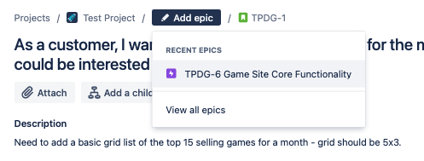
Creating an Epic
To add issues to an epic, select an issue. Just above the name/text, you should see an option to Add epic, with a grey pencil. Selecting this will allow you to add this story to an epic!
Note: Older versions of Jira may require different ways to link to an epic. This can still typically be done through the issue itself.

Slide 17
Estimation in Jira

Slide 18
Estimation is incredibly important to acknowledge in a software project.
With experience of related work, teams can make informed decisions on what work to take on in a sprint, and whether a task needs to be broken down further.
Estimation is typically metricised as Story Points.
These story points can then support the generation of burndown and burnup charts to be generated in Jira - a tool used by project managers quite often.
This section discusses how you can apply estimation in Jira.
OVERVIEW

Slide 19
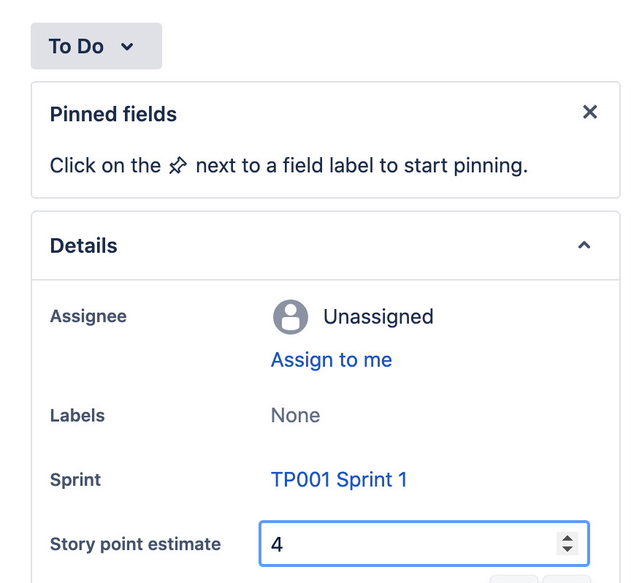
Estimation in Jira
To record Story Points in Jira, select a given issue, then scroll down to "Story Points" - from here, you can assign an estimated story point:
Jira also allows for Comments and Time tracking.
As work is picked up and worked on, the effort to complete that task can be added into the Jira system.
These metrics can then be used later to summarise time spent doing certain tasks.

Slide 20
Linking Issues

Slide 21
Issues can (and will) relate and depend on each other.
Jira allows a user to link issues together, allowing for an easy way to see how items are related, which items are acting as blockers, and more.
These are the 4 default issue links in Jira:
relates to / relates to
duplicates / is duplicated by
blocks / is blocked by
clones / is cloned by
This section discusses how you can link issues in Jira.
OVERVIEW

Slide 22
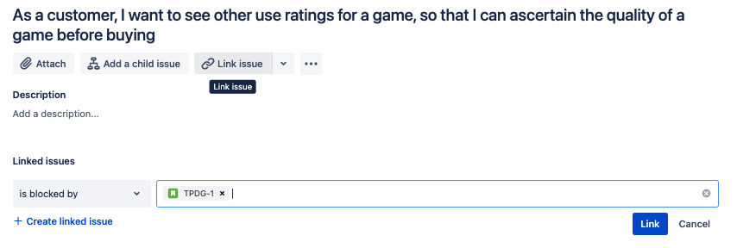
Creating an Epic
To set an issue as "is blocked by" i.e. cannot move on without another issue being completed, select an issue and select the chain icon.
You can then select "Link issue", which will allow you to search for related issues in your project:
Jira will also update the linked issue with the reverse relationship. For example, if Story 4 is blocked by Story 1, you can navigate to Story 1 and see that it blocks Story 4.
Notes:
You can also select the nature of the linked relationship. Options for this include:
is blocked by
blocks
is cloned by
clones
is duplicated by
duplicates
relates

Slide 23
Starting a Sprint

Slide 24
Sprints are the primary method of timeboxing work efforts in an Agile Scrum software project.
A sprint is a fixed time period in a continuous development cycle where teams complete work from their product backlog.
At the end of the sprint, a team will typically have built and implemented a working product increment.
Jira Software makes your backlog the centre of your sprint planning meeting, so you can estimate stories, adjust sprint scope, check velocity, and re-prioritise issues in real-time.
This section discusses how you can create a new sprint in Jira.
OVERVIEW

Slide 25
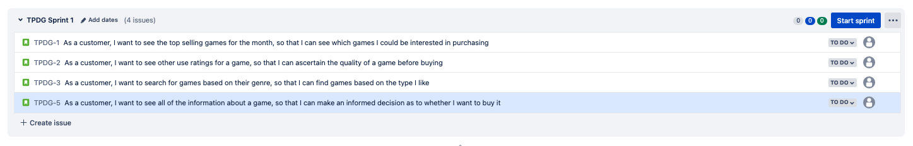
Starting a Sprint
To start a sprint in Jira, go to your Backlog.
Dragging issues into the large grey box will add items from your backlog into a sprint - this should have a name similar to <Key Name> Sprint 1.
Click the blue Create Sprint button (some versions of Jira have this as Start Sprint).

Slide 26
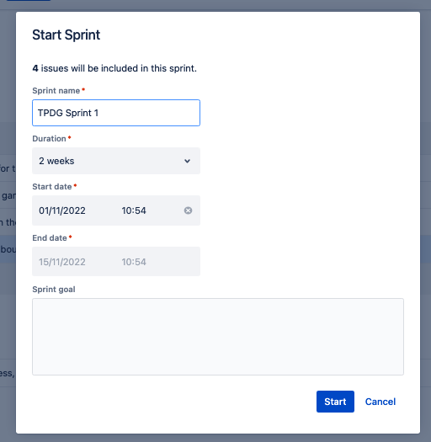
Starting a Sprint
You can enter basic details of the sprint:
The name
Duration (in weeks)
Sprint start
Sprint end
You can also enter a sprint goal, which will be presented whenever you view the sprint backlog.
A sprint goal is a shared high-level objective that describes the key outcome for each sprint that a Scrum team undertakes.
In the same way that a product vision guides the longer-term direction of a product, the sprint goal guides the development team on why it is building the current increment.
Notes:
You can then move more items from your Product Backlog into your Sprint Backlog!
Similarly, you can navigate to the Board to see the Sprint in a more traditional Kanban format.
Once all issues are inside the Sprint Backlog click Start Sprint.
As the team finishes their Sprint, you can choose to Complete Sprint, a button for which is located at the top right of the backlog.
Clicking this will present a pop-up summarising the Sprint and giving you the option of moving open items into the backlog or into a new sprint.

